Slide 1
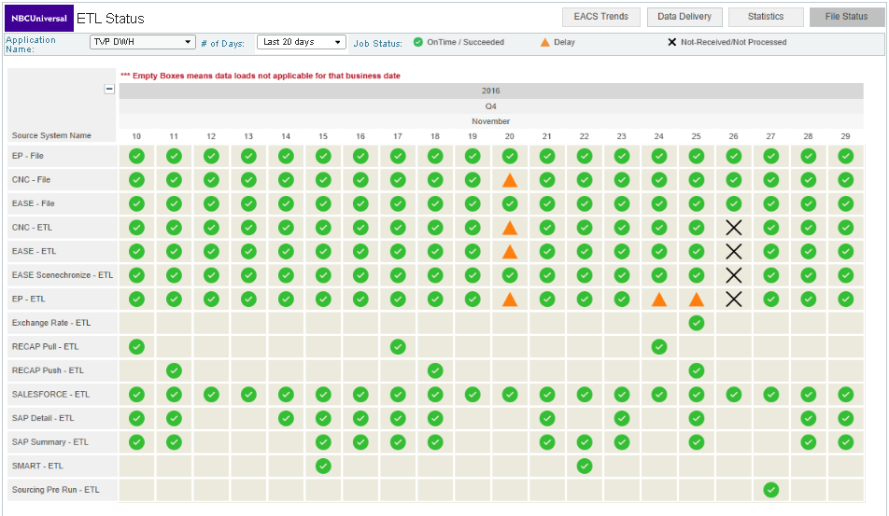
EACS Dashboard – File Delivery Status

